Slide 1


Slide 2



Esti Hirshman:
esty3975@gmail.com
Channa Makover:
channa140301@gmail.com
Pliah Paz:
pliah197@gmail.com
Tamar Flaishman:
Tamar.flaishman@gmail.com
Tamar Bardenshtain:
tamar.bardenshtain@gmail.com

Slide 3
First approach:
Separating an image into layers.
Convulsion:
Kernel selection:
Cutting of a circle of light from a traffic light image.
"Round" kernel:
Result: List of coordinates of light circles for each layer.
Problems:
Too many redundant points
Dots marked in both red and green
Attempt to solve:
Treat points which are only red or only green by ignoring points in the cut.
not good enough

Slide 4
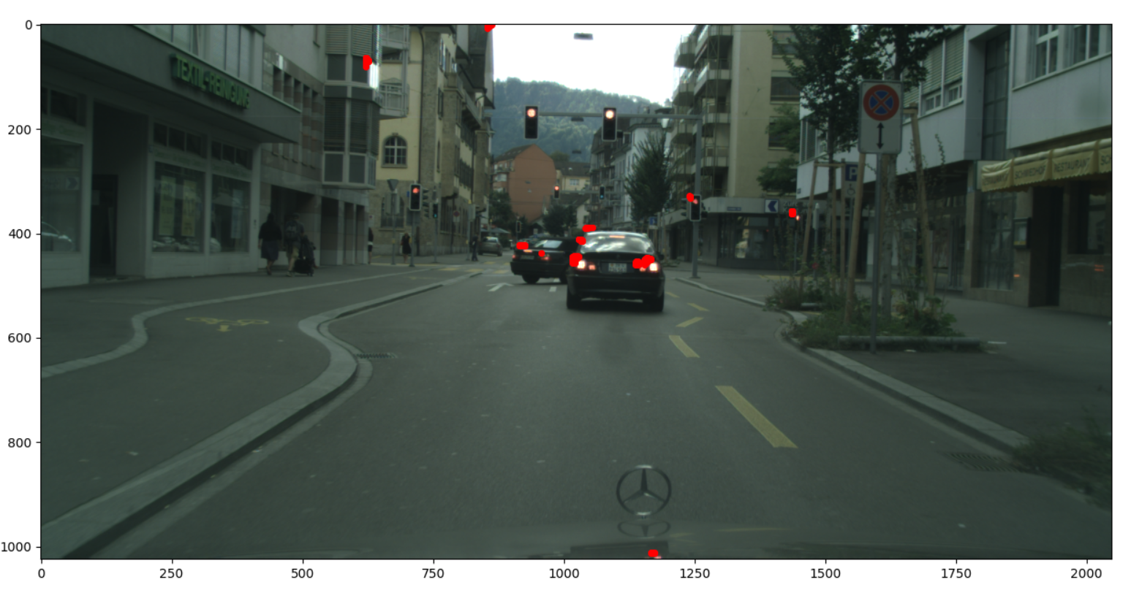


Slide 5
Improvement:
Separating the red and green layers
Convolve: Using High Pass
Result: red and green light sources
(by max filter).
Defines a brightness range of each color and filters the points in the range

Slide 6
problem : 🤔
Redundant points
solution: 💡
Drop points which are too low or too high (sky , ground)
problem: 🤔
Several different points on the same traffic light
solution:💡
Each area of 50 * 50 returns one point

Slide 7
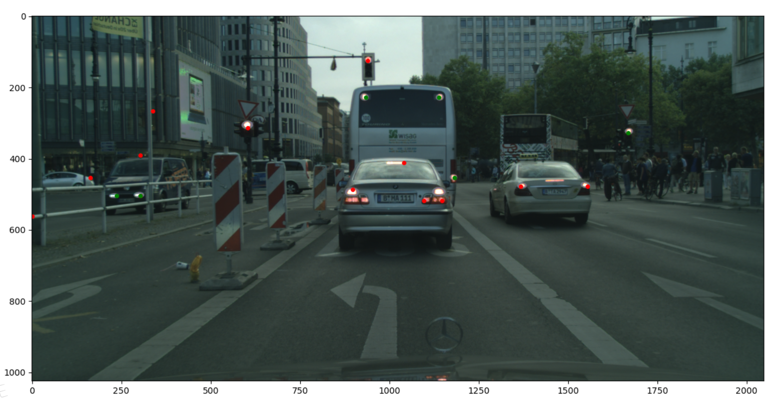

Slide 8
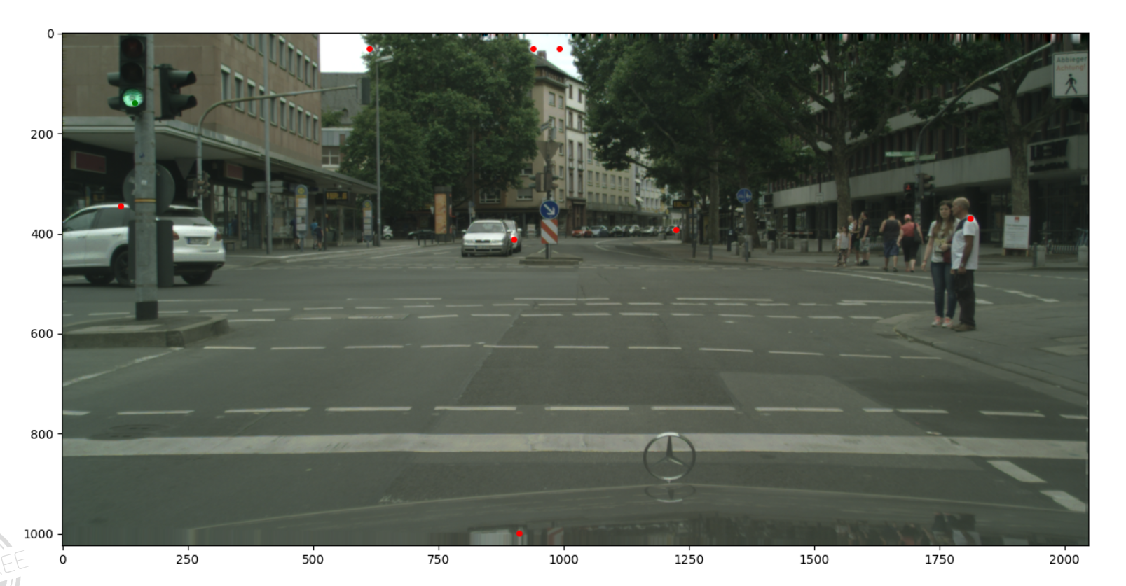

Slide 9
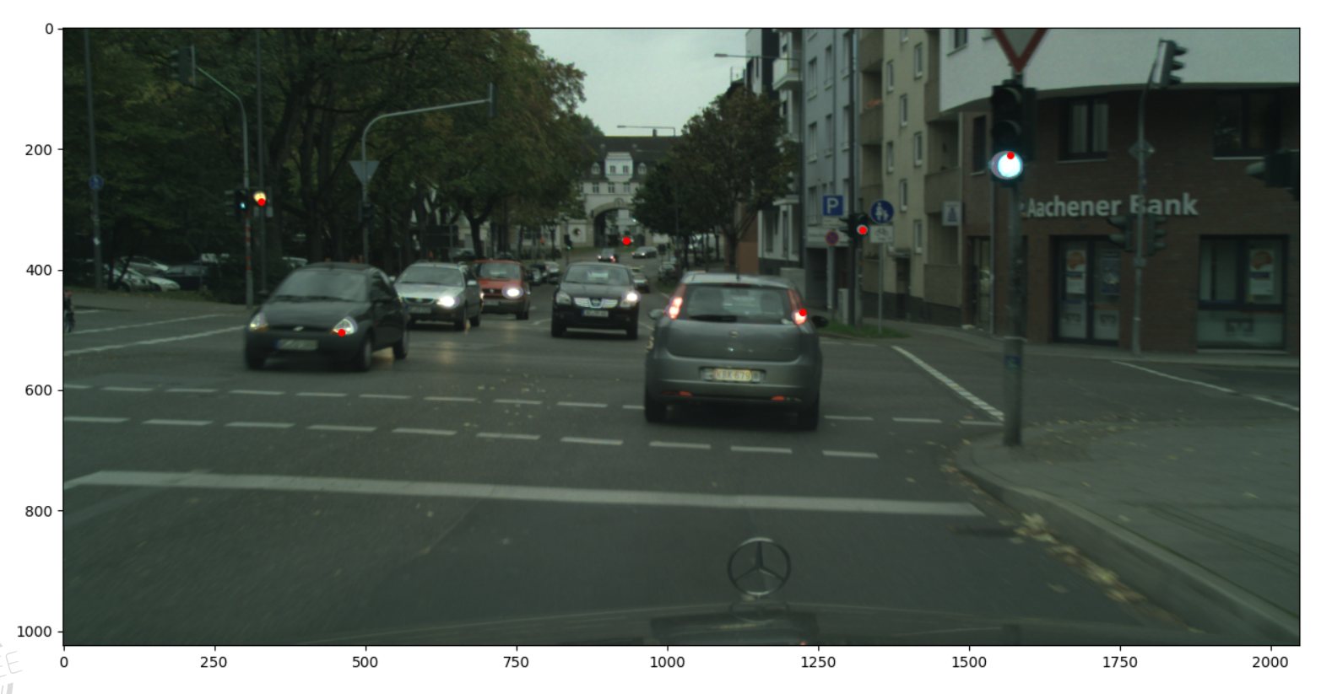

Slide 10

improvements:
Select kernel size by trial and error
Improved runtime - convolution only on every fourth pixel
(Done)
Extensions: Reduce the image to find larger traffic lights that have not been detected by the kernel
(In future…)

Slide 11
Another approach:
Convert image to black and white
Finding suspicious spots
Identify the color in the original image for each suspicious spot :
Done by setting average rgb values for each color and finding the nearest color

Slide 12
Problem:🤔 Redundant points Solution:💡 Set color values for both gray and blue to ignore such points

Slide 13
Questions?

